Slide 1


ISDS 552 GP3
TEAM MEMBERS:
DEEPAM KHIRWAR
HARSHITA DIDWANIA
KAVINDU WALIMUNIGE
SANCHIT SINGH
SATHIYA PRIYA JEEVANANDAN

Slide 2
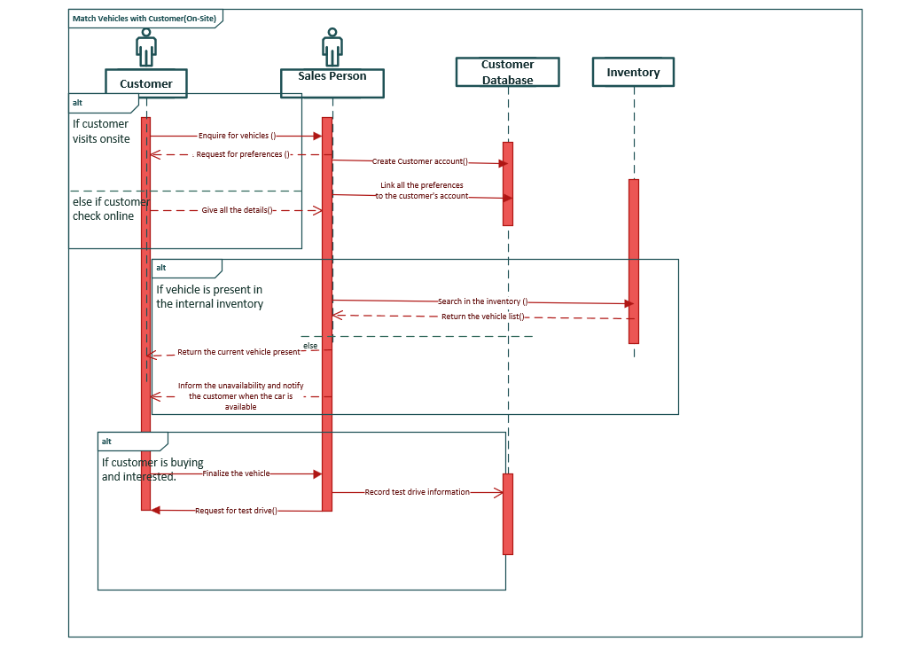
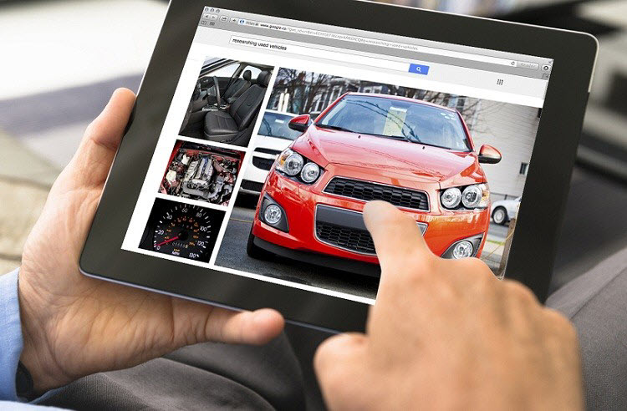
SEQUENCE DIAGRAM
MATCH CUSTOMER WITH VEHICLES

Slide 3
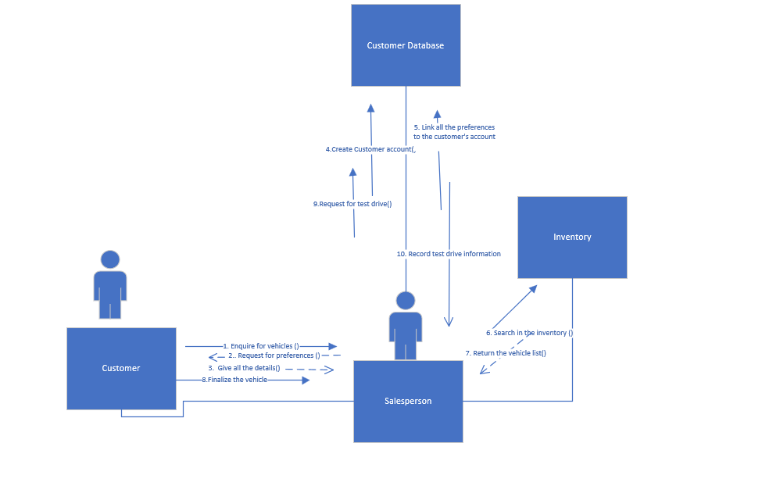
COMMUNICATION DIAGRAM
MATCH CUSTOMER WITH VEHICLES

Slide 4
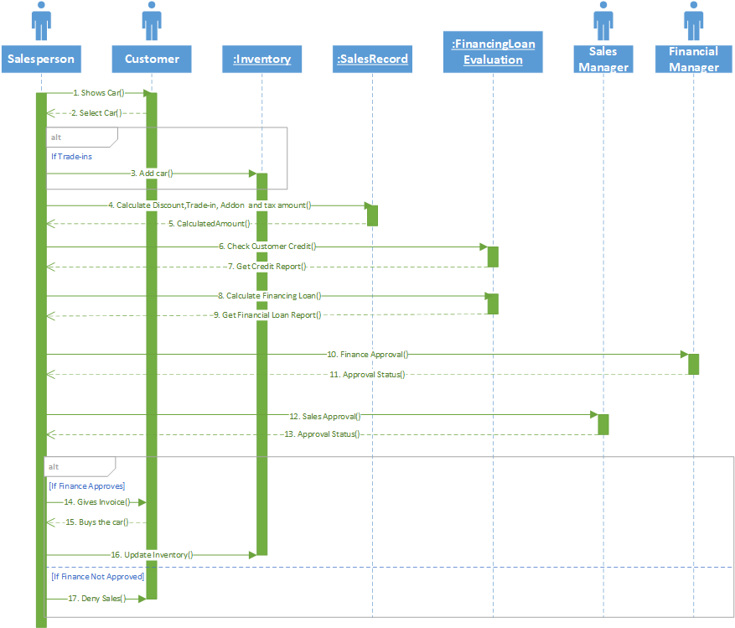
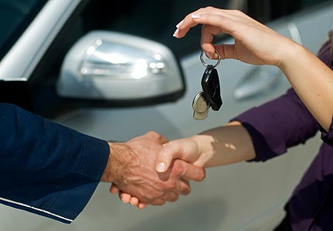
SEQUENCE DIAGRAM SELL CAR

Slide 5
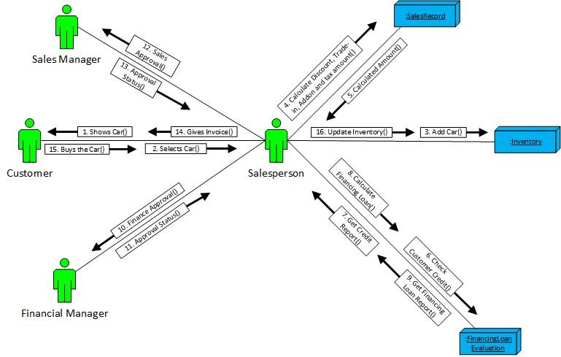
COMMUNICATION DIAGRAM SELL CAR

Slide 6
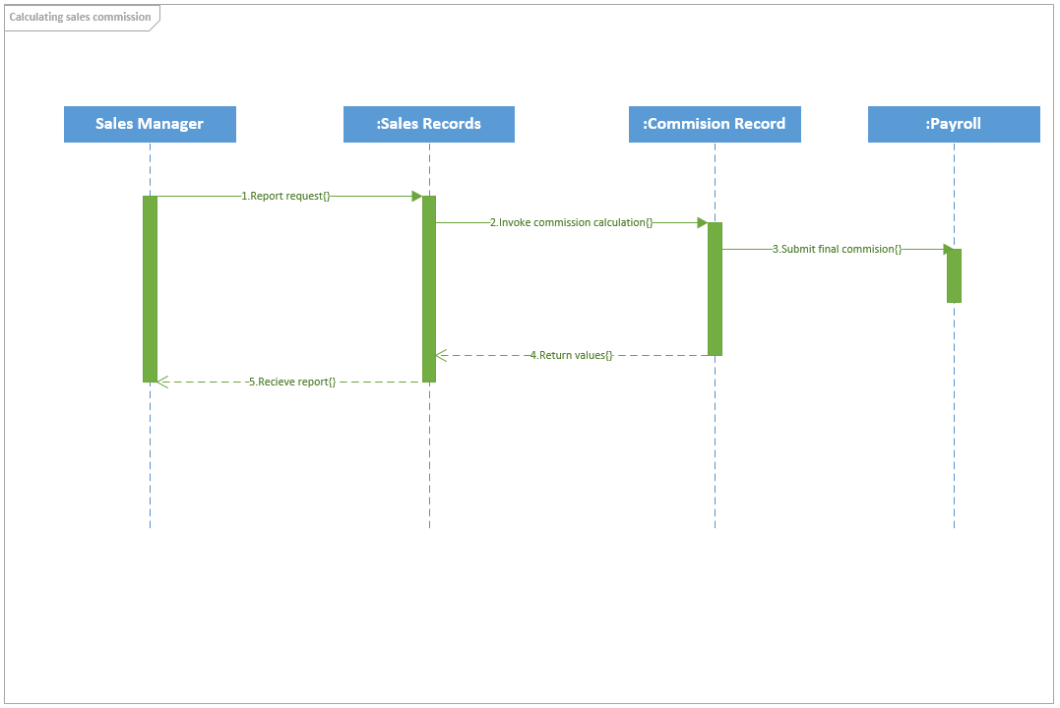


SEQUENCE DIAGRAM SALES COMMISSION

Slide 7
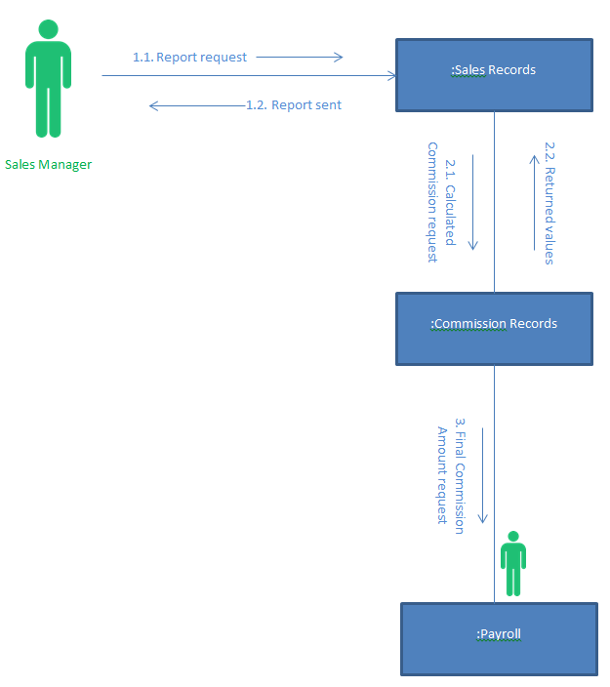
COMMUNICATION DIAGRAM SALES COMMISSION

Slide 8
Thank you!

